Slide 1


NEW SATARA COLLEGE OF ENGINEERING AND MANAGEMENT (POLY) KORTI PANDHARPUR…

Slide 2
INSTAGRAM FAKE PROFILE DETECTION

Slide 3
PRESENTED BY
Aryan Surve

Slide 4

01
02
Objective
This includes about what we are trying to solve through our project.
03
Workﬂow
This includes the proper workﬂow of our project.
Problem Statement
This includes the explanation of problem.
04
Modules
This includes different modules of our project.
05
Outputs
This includes the outputs we are expecting from our project.
06
Schedule of Project
This includes the scheduled process of whole project.

Slide 5



PROBLEM STATEMENT
Fakes and spammers are a major problem on all social media platforms, including Instagram.
This is the subject of my
ﬁnal-year project in which I set out to ﬁnd ways of detecting them using machine learning. In this dataset fake and spammer are interchangeable terms.

Slide 6
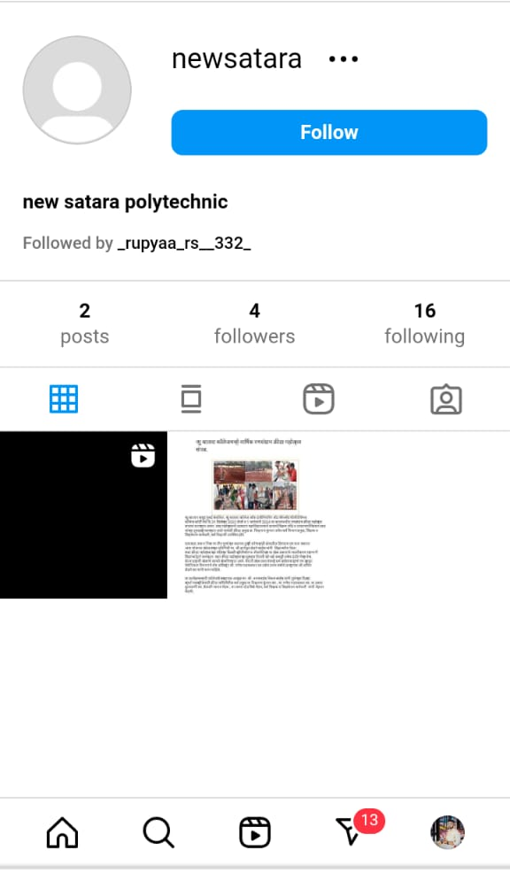
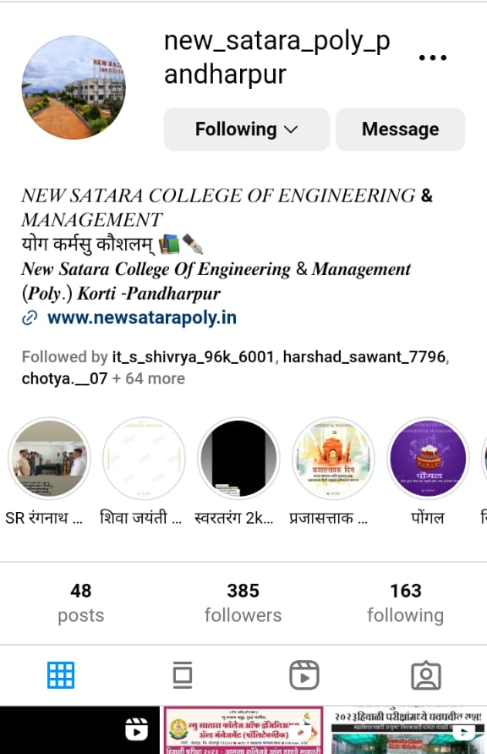
What is fake Instagram account
Orignal
fake

Slide 7


OBJ E CTIVE OF PROJECT
The objective of our project is given below:
To develop a robust solution for spammer/fake accounts, after carefully examining each instance.
To leverage machine learning so that high level of accuracy can be achieved.
Proper Data Insights and Patterns can be identiﬁed

Slide 8

WORKFLOW OF PROJ ECT
Dataset
Handling of Outliers
Exploration
Neural Network Development
Data Insights
Testing and Inference
Evaluation

Slide 9

LANGUSES USED IN PROJ ECT
1)Python
2. TensorFlow/Keras
3. Pandas
4. NumPy
4)PIL (Python Imaging Library)
scikit-learn
tkinter

Slide 10


Output Deliverables
To develop a robust solution for spammer/fake accounts, after carefully examining each instance.
To leverage machine learning so that high level of accuracy can be achieved.
Proper Data Insights and Patterns can be identiﬁed

Slide 11




Schedule
07-04-22 - Neural Network Development
10-04-22 - Evaluation Module
14-04-22 - Testing and Inference Module

Slide 12
Thank You

Slide 13
any Question?

